Slide 1
Batch - 7
M.A.M College of Engineering
Online Voting System
Team,
Ganesh M (812618205008)
Santhosh I (812618205016)
Vijayakumar M (812618205023)
Guided by,
Mrs.K.Udhaya Suriya,
Assistant Professor, Department of
Information Technology

Slide 2
Agenda:
Abstract
Introduction
Literature review
Objective
Proposed work
Implementation
Conclusion
Reference

Slide 3
Abstract:
Using Cryptography and Steganography at the same time, we try to provide Biometric as well as Password security to voter accounts.
The scheme uses images as cover objects for Steganography and as keys for Cryptography.
The key image is a Biometric measure, such as a fingerprint image. Proper use of Cryptography greatly reduces the risks in these systems as the hackers have to find both secret key and the template.

Slide 4
Abstract:
The basic idea is to merge the secret key with the cover image on the basis of key image.
The result of this process produces a stego image which looks quite similar to the cover image but not detectable by human eye.
The system targets the authentication requirement of a voting system.

Slide 5
Introduction:
An election is an official process by which person chooses an individual to hold all kind of public issues.
The elected person should satisfy all necessary needs of common people so the system of whole country works properly.
The main requirements of election system are like authentication, speed, accuracy, cost efficient and safety.
The voting system should be speedy so the valuable time of voters as well as the voting system conductors will be saved.

Slide 6
Introduction:
Accuracy means the whole system should be accurate with respect to result.
If an election is going to be conducted then lot of money and manpower is needed by using online voting system these two can be eliminated.
Safety involves the secure environment around the election area so that voters will not be under any force. In online voting system main aim is to concentrate the focus on security of voters account.

Slide 7
Literature Review:
S\No | Paper Title (Author Name, Title of the paper, Publication Name, Year of publication) | Technique | Merits | Demerits
1. | Performance Improvement using Pseudorandom One Time Password (OTP) in Online Voting System,(IOSR Journal of Computer Engineering (IOSR-JCE), Preeti Ahlawat, Rainu Nandal, (Sep. – Oct. 2015) | Pseudorandom Algorithm | The foremost advantage of and primary reason for OTPs is security. Since a single-use password will change with each login attempt, to avoid the risk | Delay in arrival of OTP ultimately causes delay in transaction completion which could sometimes lead to failure
2. | Online Voting System Security based on Cryptography, INTERNATIONAL JOURNAL OF ENGINEERING RESEARCH & TECHNOLOGY (IJERT), Warish Patel, Monal Patel, Bhupendra Ramani, 17-06-2021 | Cryptography | The cryptographic techniques such as MAC and digital signatures can protect information against spoofing and forgeries. | Cryptography does not guard against the vulnerabilities and threats that emerge from the poor design of systems, protocols, and procedures. These need to be fixed through proper design and setting up of a defensive infrastructure.

Slide 8
Literature Review:
S\No | Paper Title (Author Name, Title of the paper, Publication Name, Year of publication) | Technique | Merits | Demerits
3. | Fingerprint Voting System Using Arduino , (International Journal of Scientific Research in Computer Science, M.Nathiya, C. Sivakaran, N.Thiruchchelvan, and K.Thiruthanigesan, 2017) | Using Arduino | for the user they are simple and easy to use. No more struggling to remember your last password or being locked out due to leaving your photo ID at home. Your fingerprints are always with you. | scanners are subject to the same technical failures and limitations as all other electronic identification systems such as power outages, errors and environmental factors.
4. | Blockchain-Based E-Voting System, 2018 IEEE 11th International Conference on Cloud Computing, Friðrik Þ. Hjálmarsson, Gunnlaugur Mohammad Hamdaqa, Gísli Hjálmtýsson, 10 September 2018 | Blockchain Technology | Hacking the block chain is difficult because it requires a huge power for processing | It is complex to design and build the a secure block chain system than the comparable centralize system

Slide 9
Objective:
To build an online system this would enable voters to cast their votes on chosen candidates.
Create a secure authentication facility to check validate users logging into the voting system.
Create a database to be used to stored votes, and user information on the system.
Study and implement a security method to be used to ensure that votes being cast in the system will not be compromised and any outside attack.

Slide 10
Objective:
Create tools for the administrator to add, delete and update details of voters, candidates and sub administrators on the system.
Enable administrators to generate reports on the vote results.
Prevent voters from voting more than once for their choose candidates.

Slide 11
Proposed Work:
The proposed system will develop a website that generates online voting and voter vote for the eligible candidates.
In this project, all the details of the candidate are stored by the administrator of the society.
The end user can easily get the required specifications by using those details. So, that the system is developed to reduce the manual work involved in the voting.
This proposed online voting will pass voting information through web services and the admin of the website can view the winner's list and information reports based on polling votes this helps to facilitate the speed of the process.

Slide 12
Proposed Work:
An unique secret key is shared each voter to ensure the Security.
This secret key is this secret key is encrypted using cryptography and the encrypted key is embedded to the stego image of the finger print to provide a double security for the secret key.
So that if an intruder got the stego image and manage to split the secret key from the image they only see the encrypted key. Using these two techniques we provide double security to our voter’s credential.

Slide 13


Implementation
Login
OTP Verification

Slide 14
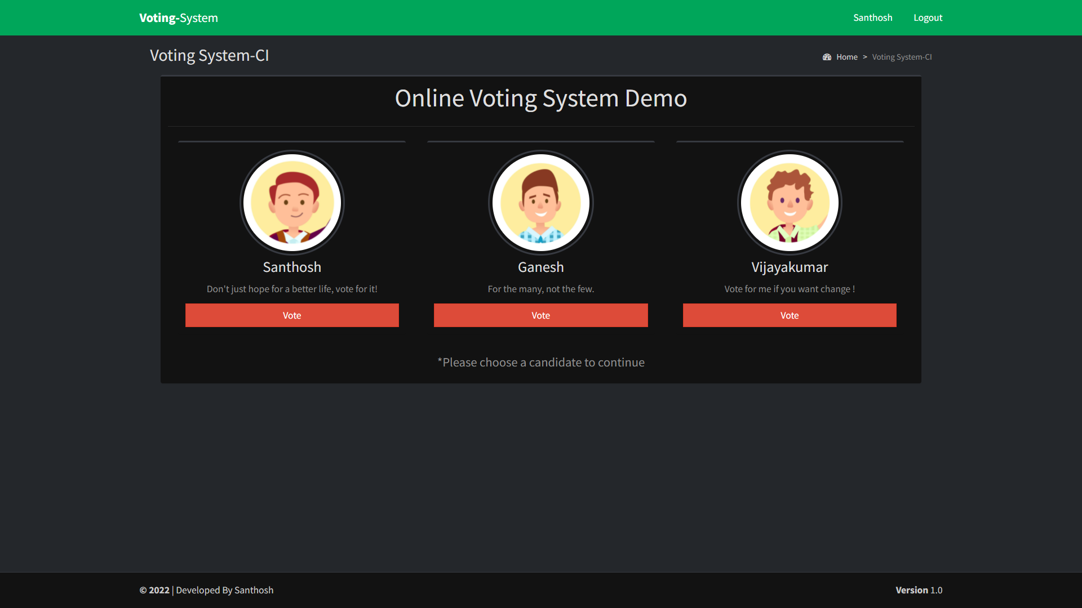

Implementation
Candidates List
Final Greeting

Slide 15
Conclusion:
Online Voting Systems have many advantages over the traditional voting system.
Some of these advantages are less cost, faster generation results, easy accessibility, accuracy, and low risk of human and mechanical errors.
It is very difficult to develop online voting system which can allow security and privacy on the high level.
Future development focused to design a system which can be easy to use and will provide security and privacy of votes on acceptable level by proper authentication and processing section. It is easy to use and it is less time consuming. It is very easy to debug.

Slide 16
Reference:
[1] William Stallings, “Cryptography and Network Security Principle and Practices”, Third Edition, pp. 67-68 and 317-375, Prentice Hall, 2003
[2] Sutaone, M.S. and Khandare, M.V., “Image based steganography Using LSB insertion technique”, IEEE WMMN, pp. 146-151, January 2008.
[3] “Electronic Voting,” Encyclopedia of Computers and Computer History, prepared by Lorrie Faith Cranor and edited by Raul Rojas, published by Fitzroy Dearborn, 2001.
[4] Rossler T.G (2011),”E-voting: A survey and Introduction”, Available at
http://wiki.agoraciudadana.org/images/5/56/An%2BIntroduction%2Bto%2BElectronic%2BVoting%2B Schemes.pdf Retrieved on 15th June 2012.

